Slide 1
BIOGER Bioinformatics platform bioinfo.bioger.inrae.fr
Nicolas Lapalu / Adeline Simon
BIOGER meeting – 20 september 2021

Slide 2
Genomics project - life cycle
When and How we can help you ?
1- Project Proposal
Experimental design; technological choices
Data Management Plan (DMP): support on genomics data
2- Experiments – Biological material
It’s your business !
Protocol and associated metadata
3- Genomics raw data
Long term storage of raw data with metadata
Availability for download or in-situ analyses
4- Analyses
Carry out analyses / support for analyses (trainee supervision, training session)
Technology forecasting
Development of tools/workflows if necessary
5- Results: availability, integration
Web Interface development (private / public)
6- Data / Result release
Publications
Publishing data in public repositories

Slide 3

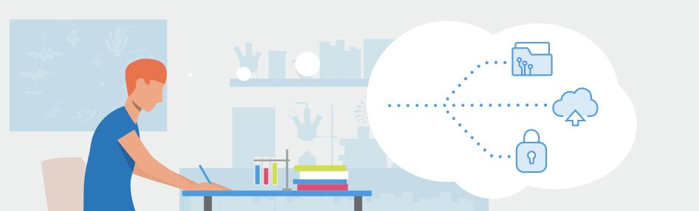
1- Project Proposal
Experimental design; technological choices
Data Management Plan (DMP): support on genomics data
DMP : Cf AG_sciences_BIOGER_2020
The ANR introduces a Data Management Plan for projects funded in 2019 onwards
In line with its Open Science policy, the French National Research Agency (ANR) requires all projects funded in 2019 onwards to produce a Data Management Plan (DMP) setting out how research data will be produced, reused, stored, protected, disseminated and, where applicable, retained for a significant period of time. The aim is to improve forward planning and rigorous monitoring throughout the research process in anticipation of the sharing, reuse and perpetuation of data in accordance with the principle: “as open as possible, as closed as necessary”. The ANR follows the recommendations of the Committee for Open Science (CoSO), which it has consulted on this matter, and uses the Science Europe DMP template. The Agency has worked closely with the French Institute for Scientific and Technical Information (INIST) to ensure that its DMP template is integrated into the OPIDoR DMP portal, so that plans can be completed online. See below for four key questions about this process, and the corresponding answers.

Slide 4
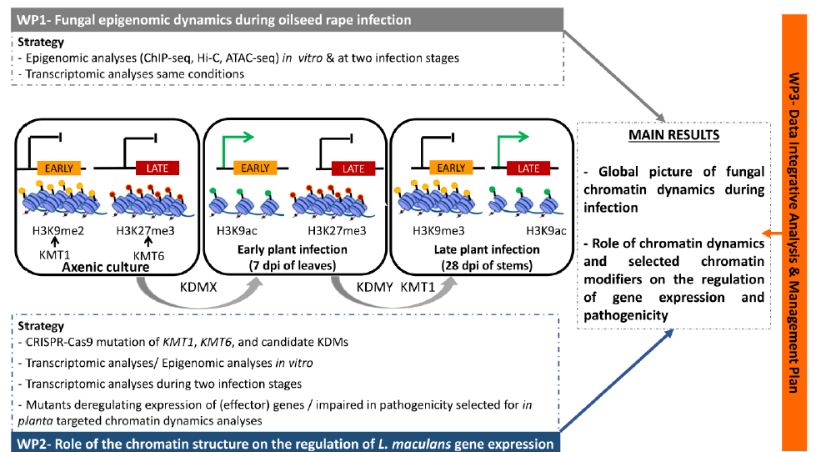
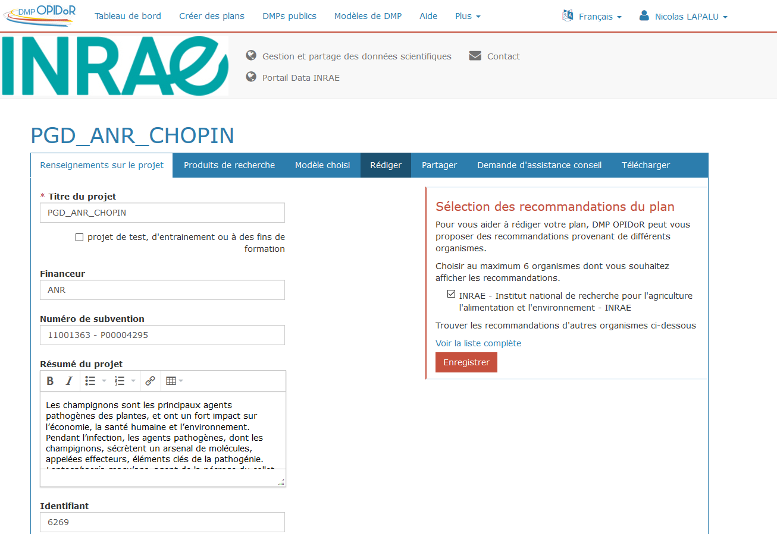

1- Project Proposal
Experimental design; technological choices
Data Management Plan (DMP): support on genomics data
Example CHOPIN project
(Jessica SOYER
2020- 2023)
back and forths between the project and the DMP
v1
v2
v3
https://dmp.opidor.fr/

Slide 5
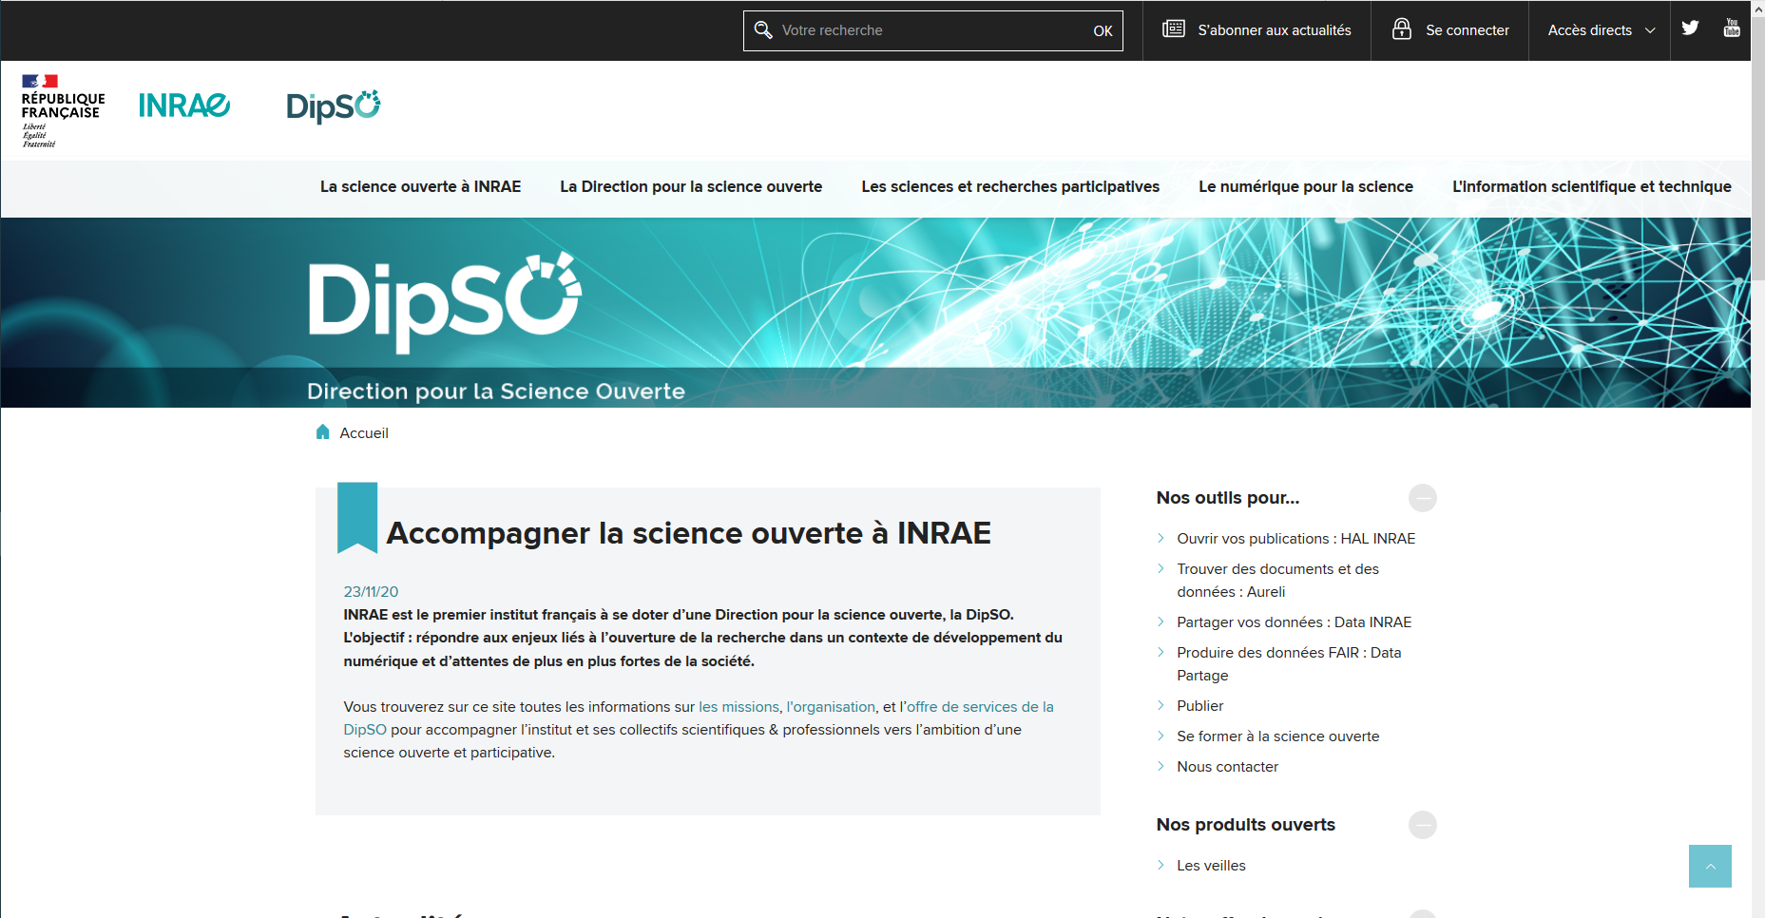
1- Project Proposal
Data Management Plan (DMP): support on genomics data
« référent données opérationnel » : a person in the unit who can tell you how to manage your data or where to find the resources to handle them.

Slide 6
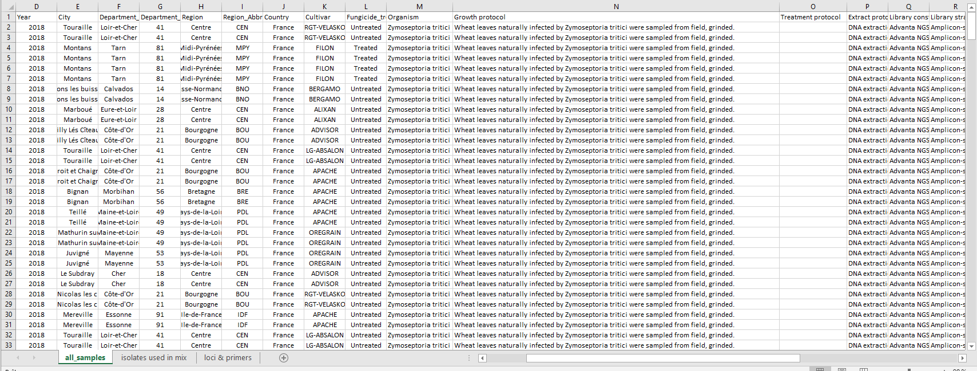
2- Experiments – Biological material
Protocol and associated metadata
Experiments
Data (Raw sequencing files)
Metadata (description of the samples, protocols…)

Slide 7
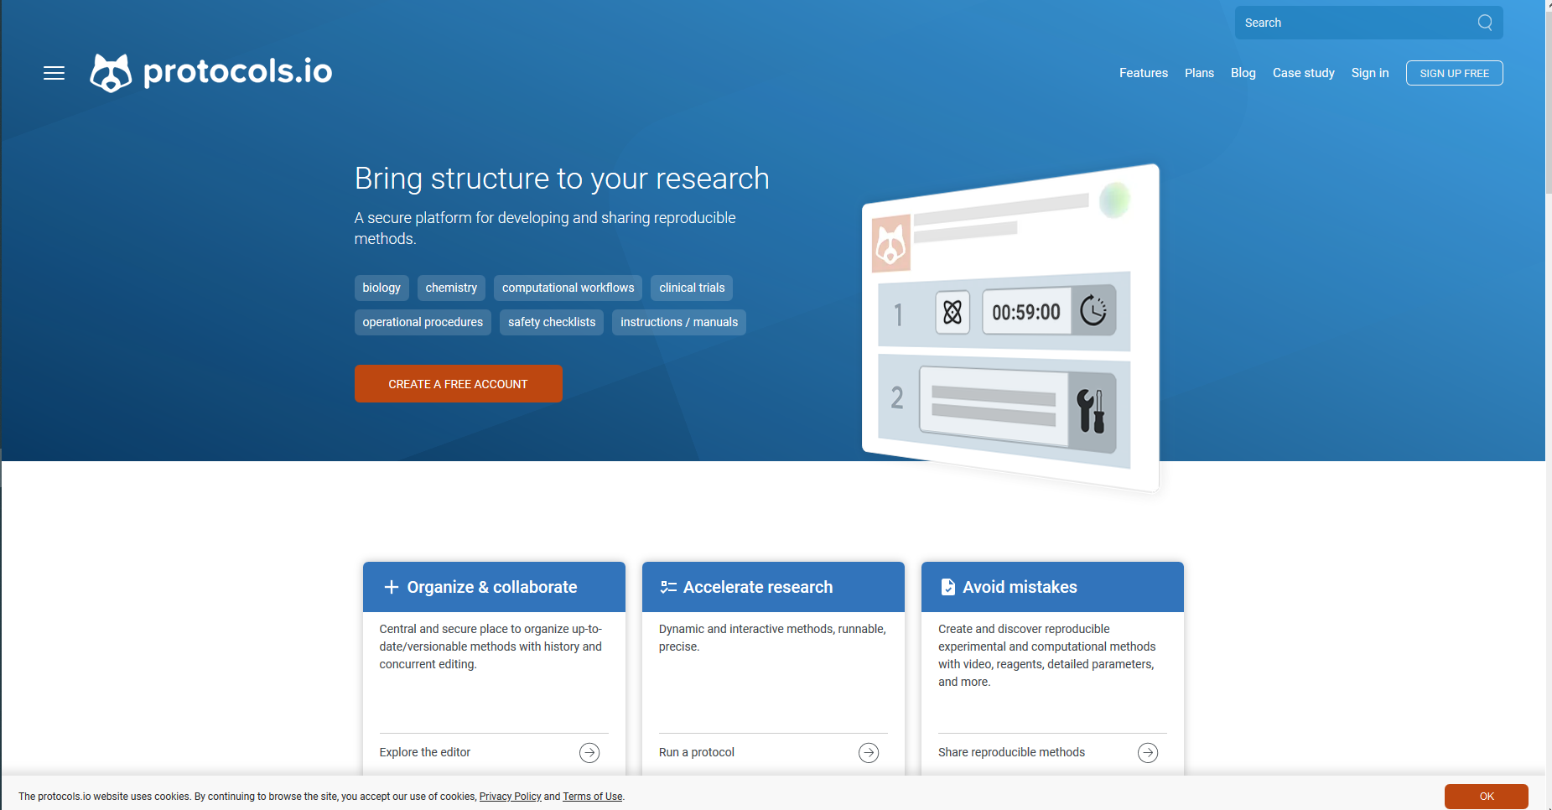
2- Experiments – Biological material
Protocol and associated metadata

Slide 8
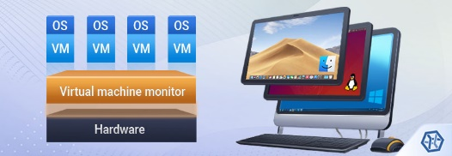
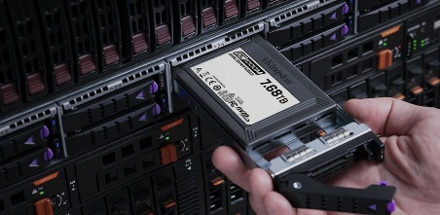
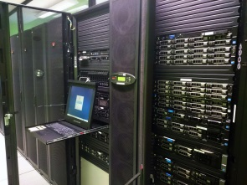
3- Genomics raw data
Availability for download or in-situ analyses
Availability for download or analyses
work : 8To
(1200€ / year)
Web portal (virtual machine at Genotoul ; 320€ / year)
public / private download
https://bioinfo.bioger.inrae.fr/portal/data-browser/
GENOTOUL: genologin.toulouse.inra.fr
Direct link to raw data with access to a working directory to perform high computing analyses
High-performance computing:
parallelization / RAM Memory

Slide 9
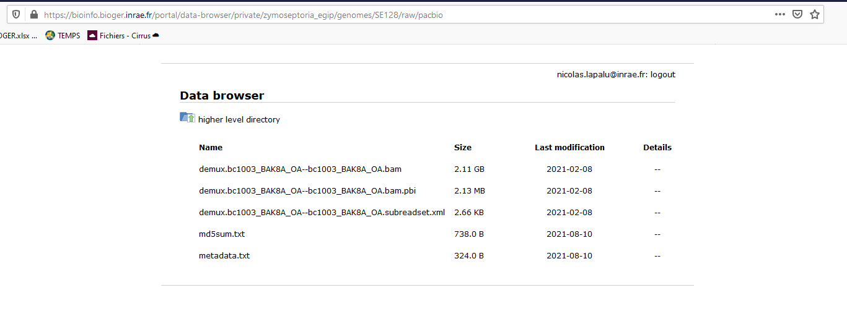
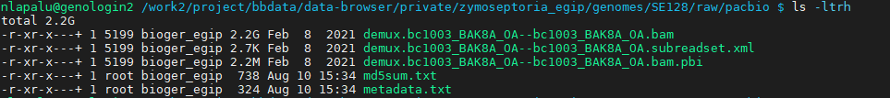
3- Genomics raw data
Availability for download or in-situ analyses
Availability for download or analysis
Path to data
Restricted access
Web
Raw Data
Metadata
Cluster
Restricted access per group

Slide 10
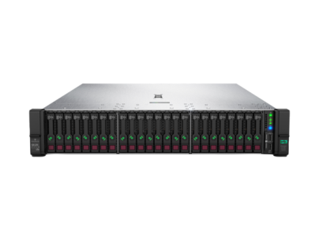
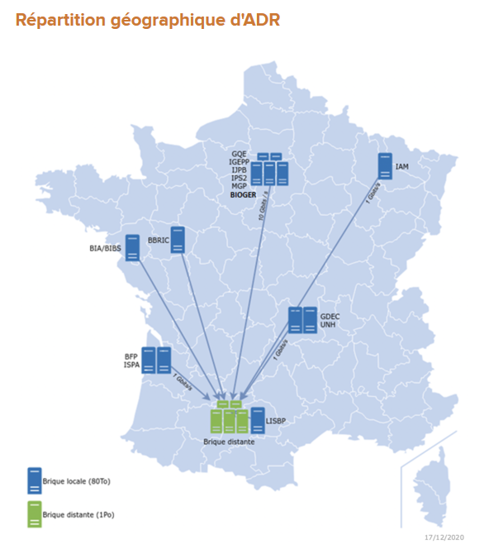
3- Genomics raw data
Long term storage of raw data with metadata
Long term data storage (archive)
Server AgroDataring (80To)
Funded by SPS (27k euros)
Localized at DataCenter IDF + DataCenter Toulouse (backup)
(annual datacenter fees: 1500€)
System administration (Nicolas) with ADR consortium
https://datapartage.inrae.fr/Gerer/Stocker-les-donnees/AgroDataRing
Use cases at BIOGER:
Project archive
Backup large datasets not released in public DB.

Slide 11
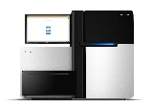
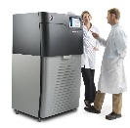




4- Analyses
Carry out analyses / support for analyses
Area of expertise
Fungi
Sequencing
Assembly
Genome
Structural analysis
(duplications)
Structural / functional analyses
Polymorphism
Epigenomics
Genes
TE
plant
Target
plant
mRNA
mRNA
mRNA
sRNA
Transcriptome:
Diff exp / Assembly
Small RNAs anlaysis

Slide 12
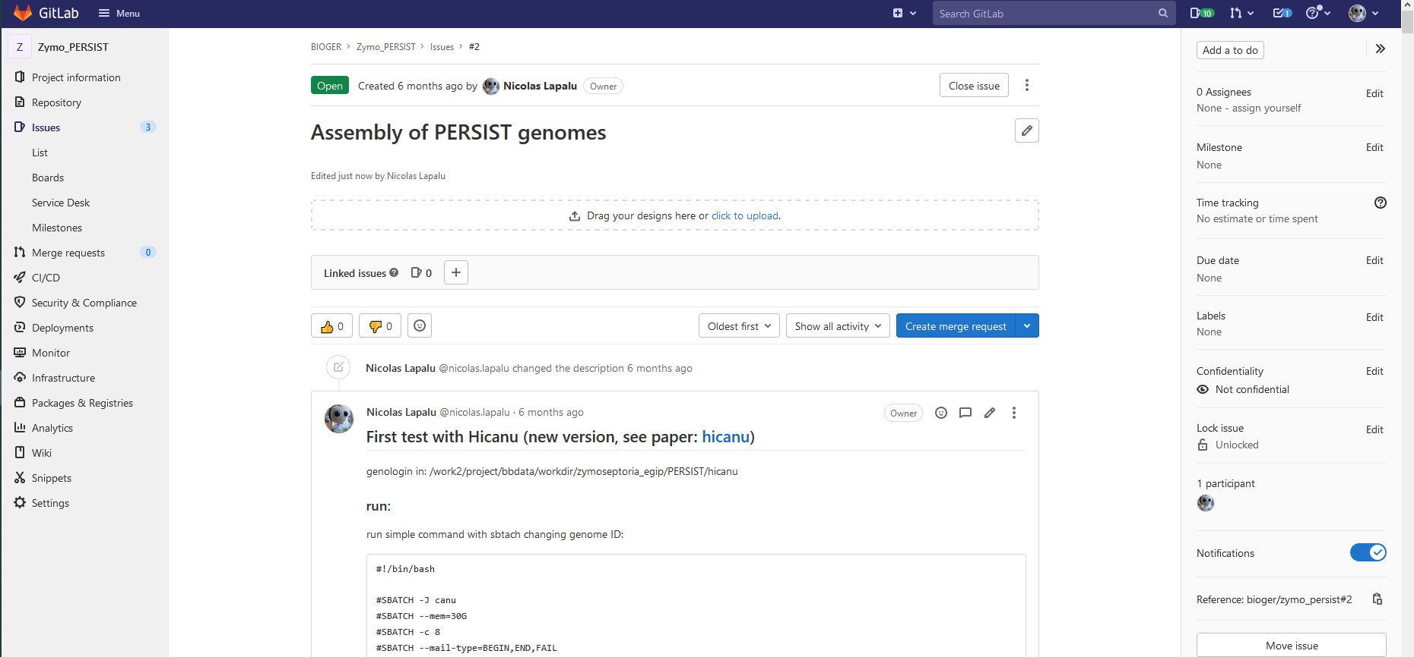
4- Analyses
Carry out analyses / support for analyses
worklog (notebook)
https://forgemia.inra.fr : Easy to write / update / formatting
LDAP access ; ask us for BIOGER group

Slide 13
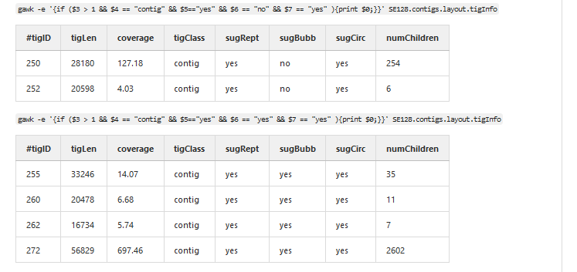
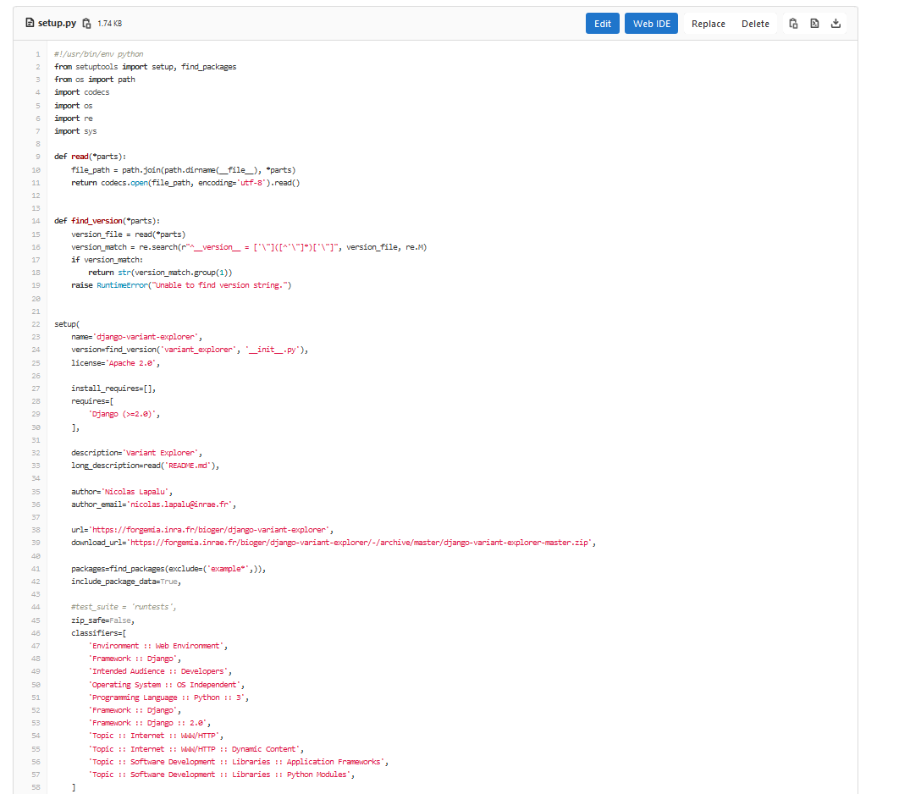
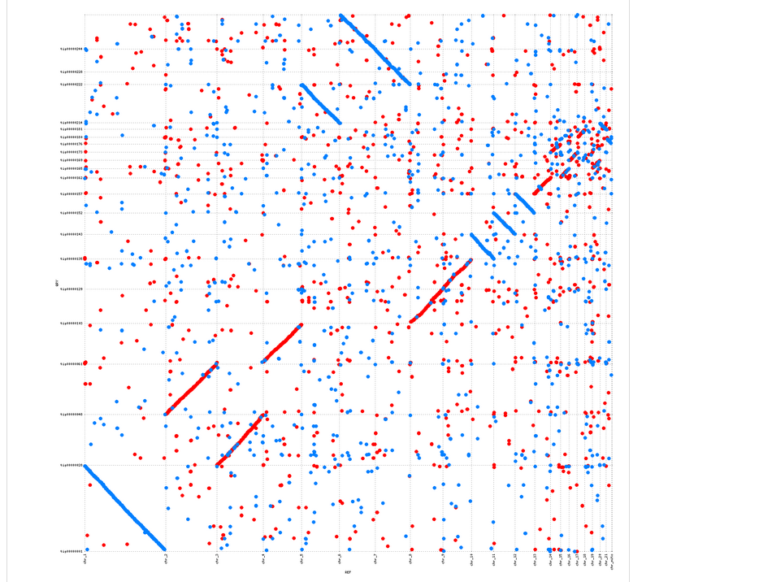
4- Analyses
Carry out analyses / support for analyses
worklog (notebook)
https://forgemia.inra.fr
Table:
Code formatting (useful for scripts or R commands)
Figure:

Slide 14
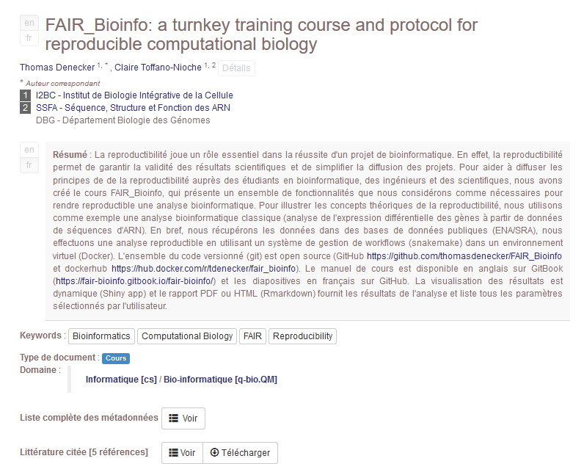
4- Analyses
Carry out analyses / support for analyses
worklog (notebook)
Scheduled training sessions

Slide 15
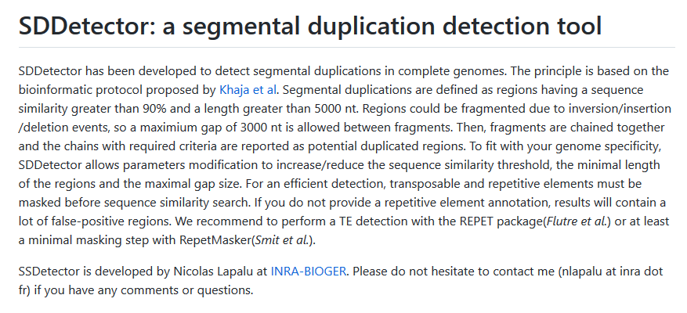
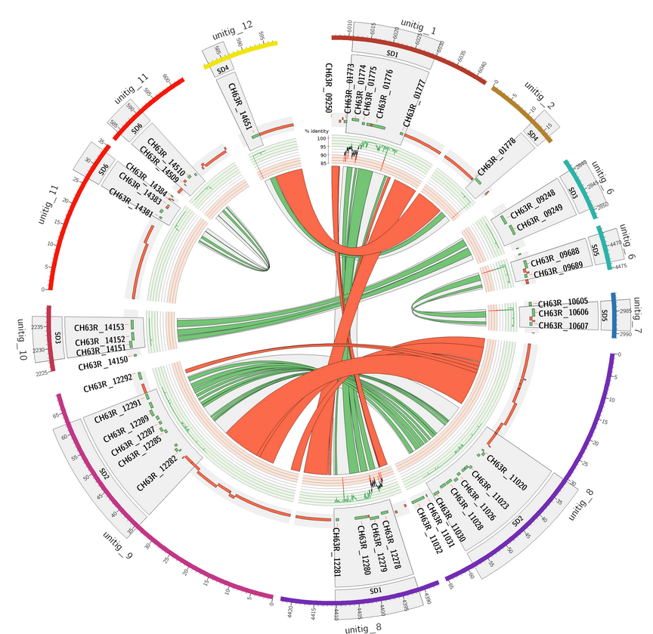
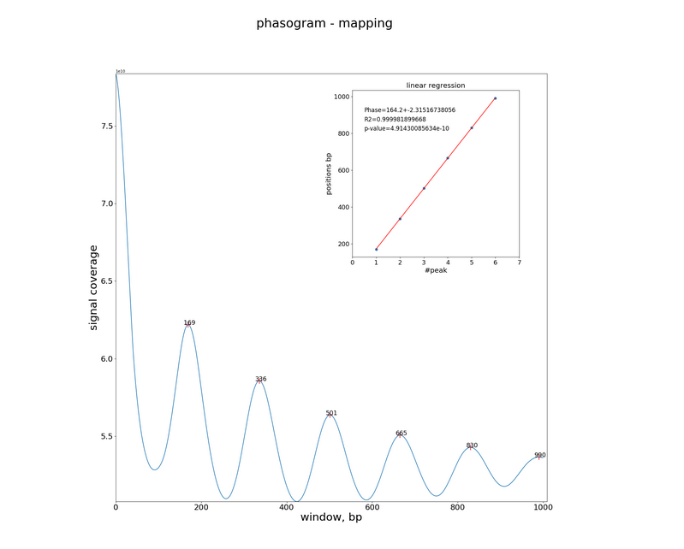
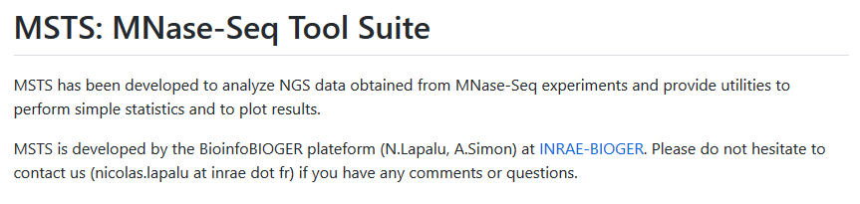
4- Analyses
Development of tool/workflows if necessary
https://github.com/nlapalu/SDDetector
Segmental Duplications
Published in J.Dallery et al.2017
Re-used/cited in https://doi.org/10.1111/1755-0998.13368 (Oyster),
https://doi.org/10.1093/bioinformatics/bty586 (benchmark),
https://github.com/nlapalu/MSTS
Maine-Seq data
Draft revision, Clairet et al,

Slide 16
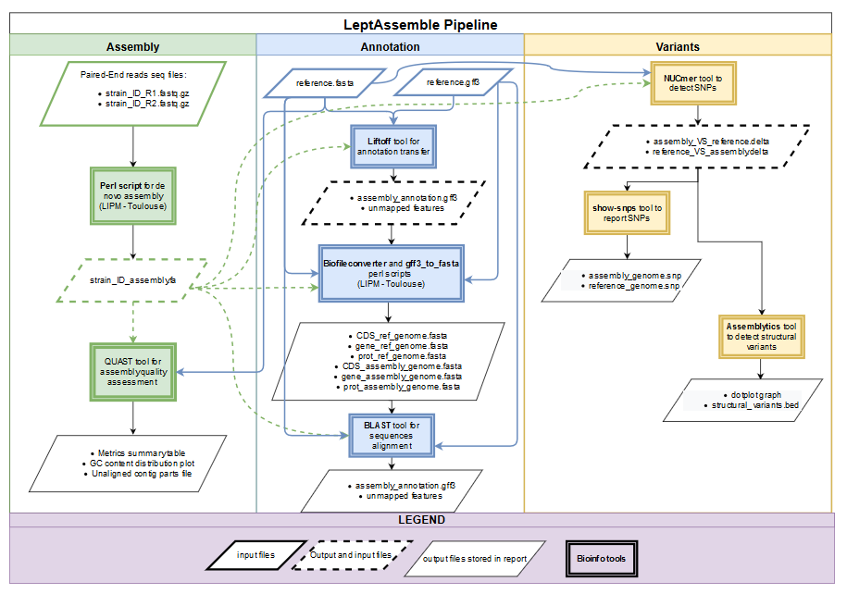
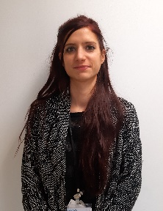
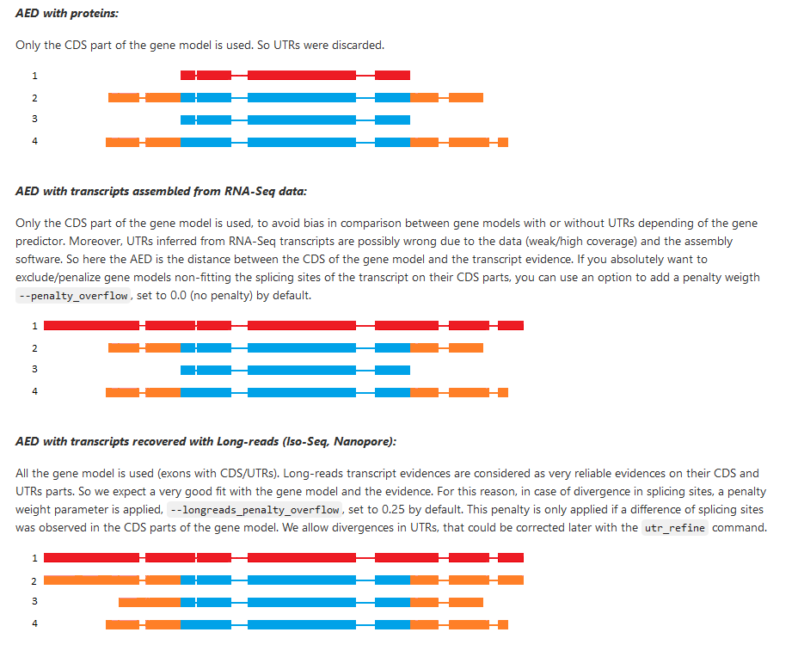
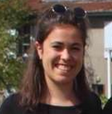
4- Analyses
Development of tool/workflows if necessary
https://forgemia.inra.fr/sps-bioinfo/leptassemble
Assembly / Annotation workflow
A.Sandri, AAP SPS bioinfo
SPS Bioinfo Meeting
January 2022
https://forgemia.inra.fr/bioger/ingenannot/
Gene annotation
L.Lamothe, Master 2

Slide 17


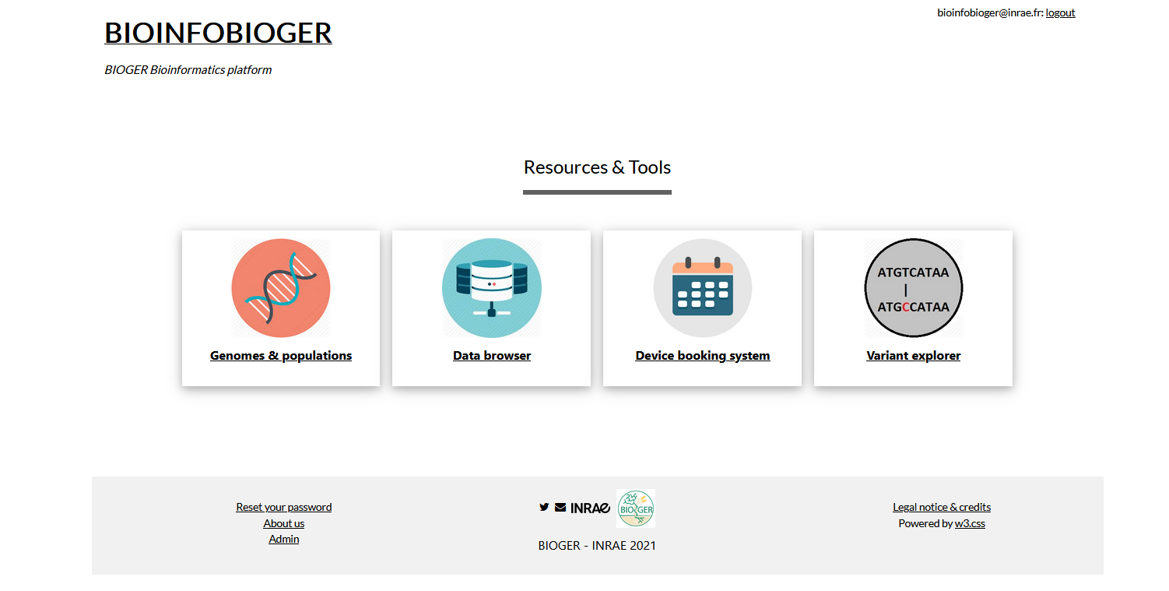
5- Results: availability, integration
Web Interface development (private / public)
https://bioinfo.bioger.inrae.fr

Slide 18
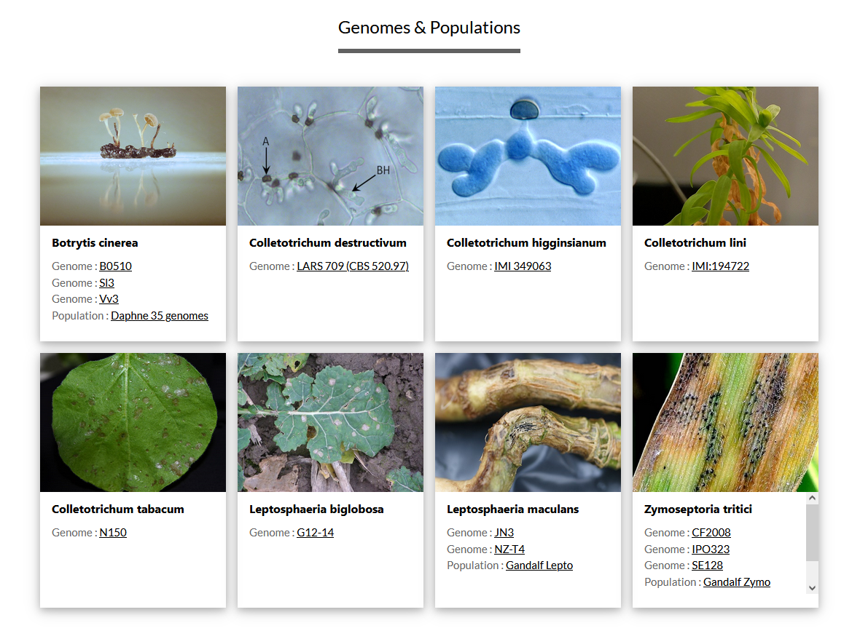
5- Results: availability, integration
Web Interface development (private / public)

Slide 19
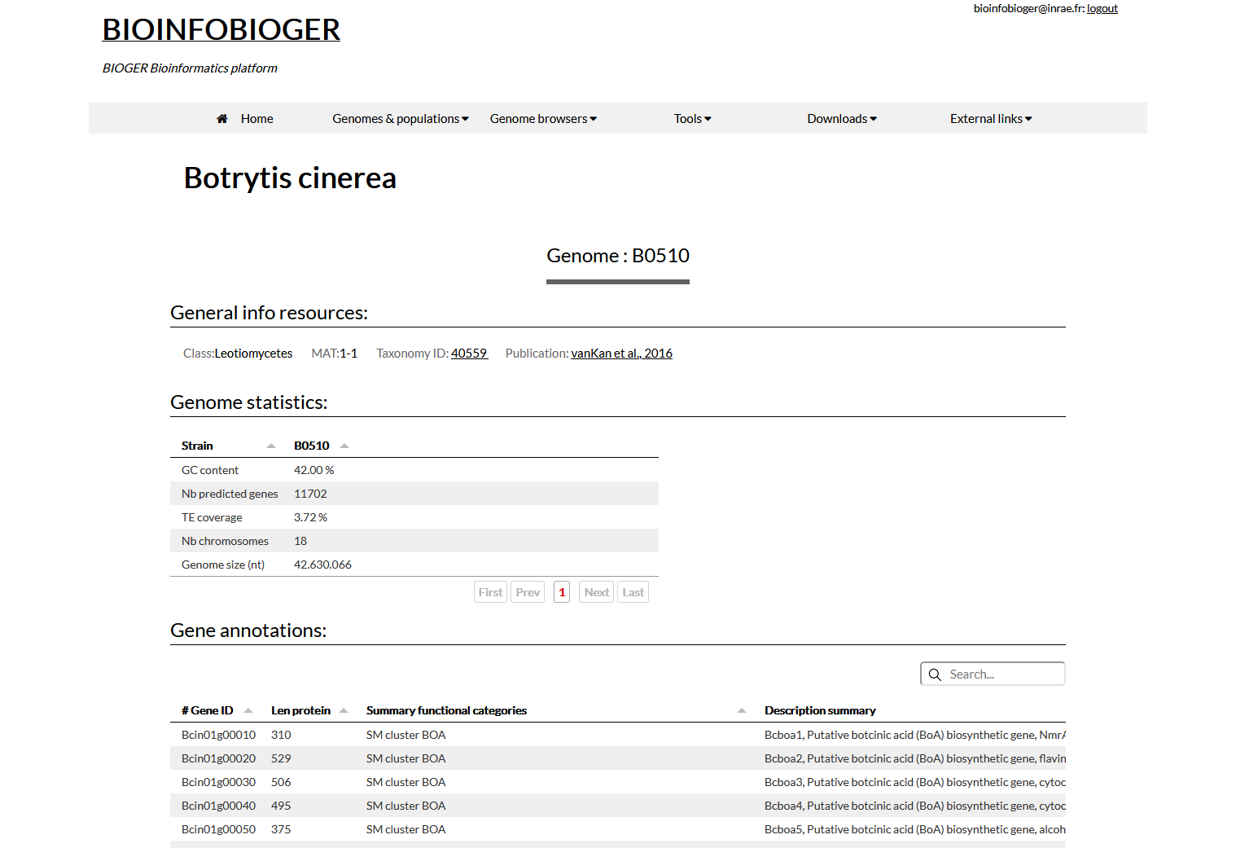
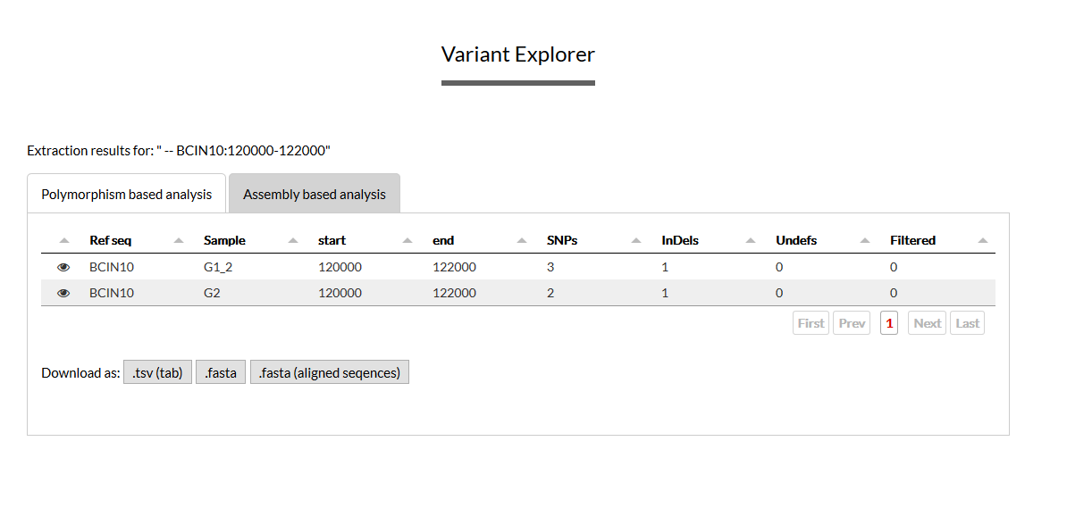
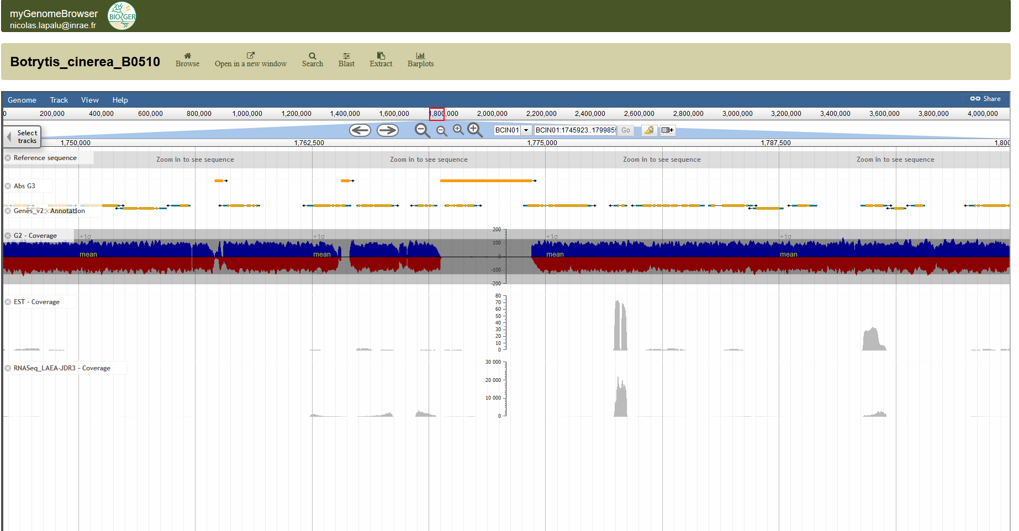
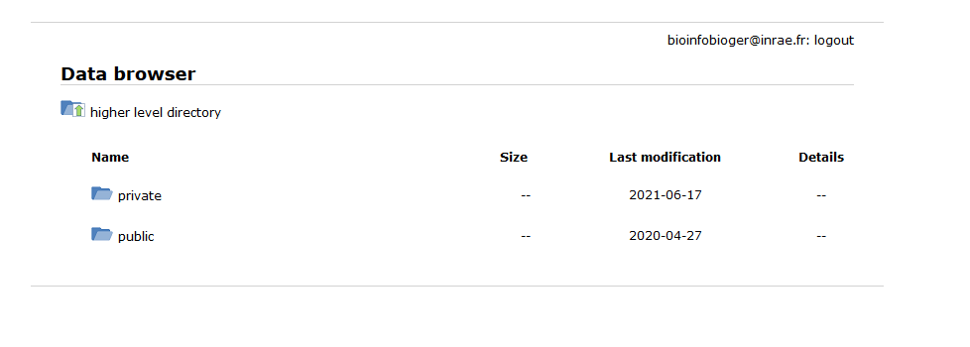
5- Results: availability, integration
Web Interface development (private / public)
Genome & Populations
Polymorphism / Structural variation
Data Browser
Genome Browser
=> Demo

Slide 20
6- Data / Result release
Publications
Publishing data in public repositories
In progress (working draft):
Colletotrichum destructivum genome (A.Lu internship)
Maine-Seq (Fusarium, Botrytis, Leptosphaeria) (SPE nucleosomes)
Botrytis (Pacbio strains, small RNAs) (Paris-Match SPE, Daphne BASC)
Zymoseptoria reannotation (L.Lamothe internship)
Release data:
- RNA-Seq / Chip-Seq data to GEO (Metadata available in data-browser)
- Sequencing raw data
- Fully assembled genomes
All data are interesting !:
Data INRAE: get a DOI to a dataset
Data Paper: Publish your dataset

Slide 21
Perspectives
With your help : supply more data & results to bioinfo.bioger.inrae.fr ; add functionalities ?
Semantic web: omics data integration with graph of linked objects (CHOPIN project)
« micro » workshops: info/bioinfo/stats practical sessions with different topics
https://docs.google.com/spreadsheets/d/1DklLPKqQY7hzIGCyX5a6KfZiYG3FfMLhS60Y3DoQODg/edit?usp=sharing
Register as trainer or participant ; add topics…
Ideas ? Tools ? Dev ?
Phenotypic analysis (log, follow, …)
Fungi collection (log, follow, …)

